Slide 1
Introduction to Tableau
Part 3
Notes:
Welcome back to Data Society! We have a great class ahead of us today.

Slide 2
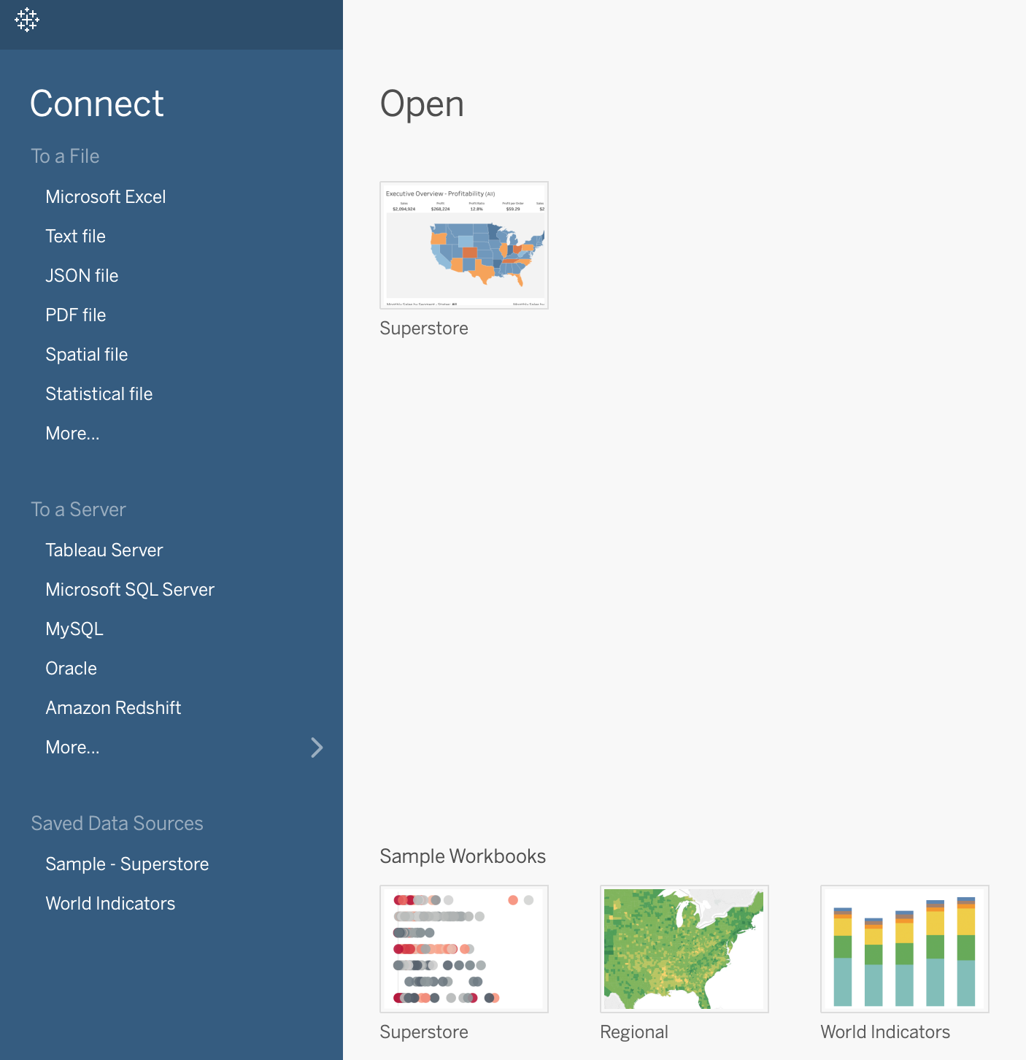
Recap: importing data
Import data with the Connect panel.
Supports multiple formats such as:
Microsoft Excel (.xlsx).
Text (.txt, .csv).
JSON (.json).
PDF (.pdf).
R data format (.RData).
Supports Database Connections such as:
MySQL.
Oracle.
Redshift.
Notes:
The purpose of this slide is to define the different data types and database connections Tableau supports from the Connect panel.

Slide 3
Import World Data : CSV
Let’s import some pieces of the world dataset today and see what sort of insights we can reveal.
Click the “More...” item to browse your local CSV files.
Notes:
The purpose of this slide is to instruct students to import a few CSV files for manipulation.

Slide 4
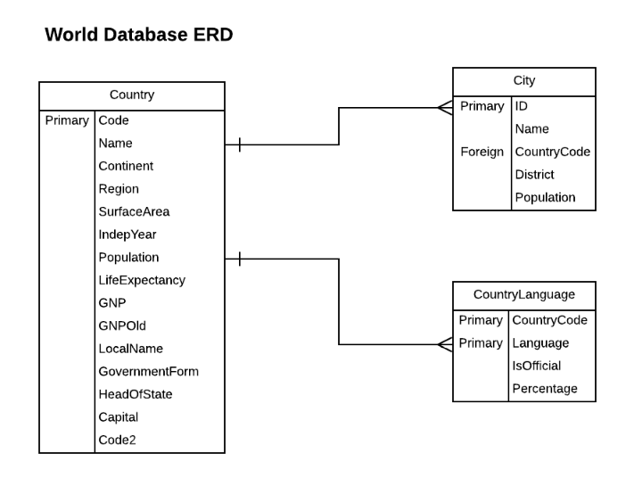
Recap: World Database
For now, import the following three CSV files:
country.csv
city.csv
countrylanguage.csv
We’ll use the other CSV files during our Exercises.
Notes:
The purpose of this slide is to provide a schematic overview of the components of the world database students will be manipulating in this module.

Slide 5
Recap: joining datasets using Relationships
It is often necessary to combine data from multiple places - different tables or even data sources - to perform a desired analysis.
Previously, Tableau utilized joins in order to merge and combine data in strategic ways.
While it is still possible to perform traditional joins in Tableau, it is no longer the default option.
Tableau has introduced a feature called Relationships to minimize the amount of data pre-processing required to visualize related datasets in multiple ways.
Notes:
The purpose of this slide is to recap the Relationships feature, which has taken the place of joins in Tableau as the default option for combining datasets.

Slide 6
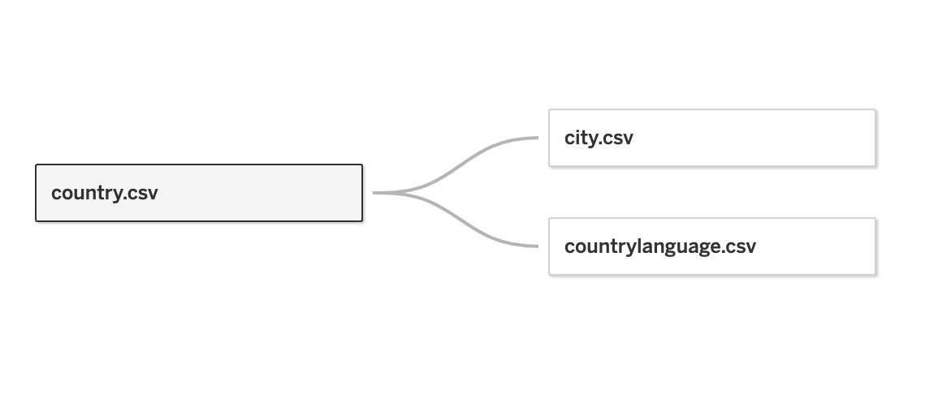
Recap: Relationships are contextual joins
A single relationship will support all join types at the same time.
For Measures, this means all values are always retained, even if they’re unmatched nulls (not missing values).
For Dimensions, relevant domains will be displayed across tables, and Tableau will display all values in the domain by default (even if there are no matching Measure values).
What dimension serves as the key linking city.csv and countrylanguage.csv to country.csv?
Notes:
The purpose of this slide is to recap examples of how relationships support various join types.
ASK students the question under the graphic and COMMENT on their responses. HINT: You might want to refer back to slide 4 (and display it for people to use as a reference).
The answer is country code (not country name, which is not part of the language dataset).

Slide 7
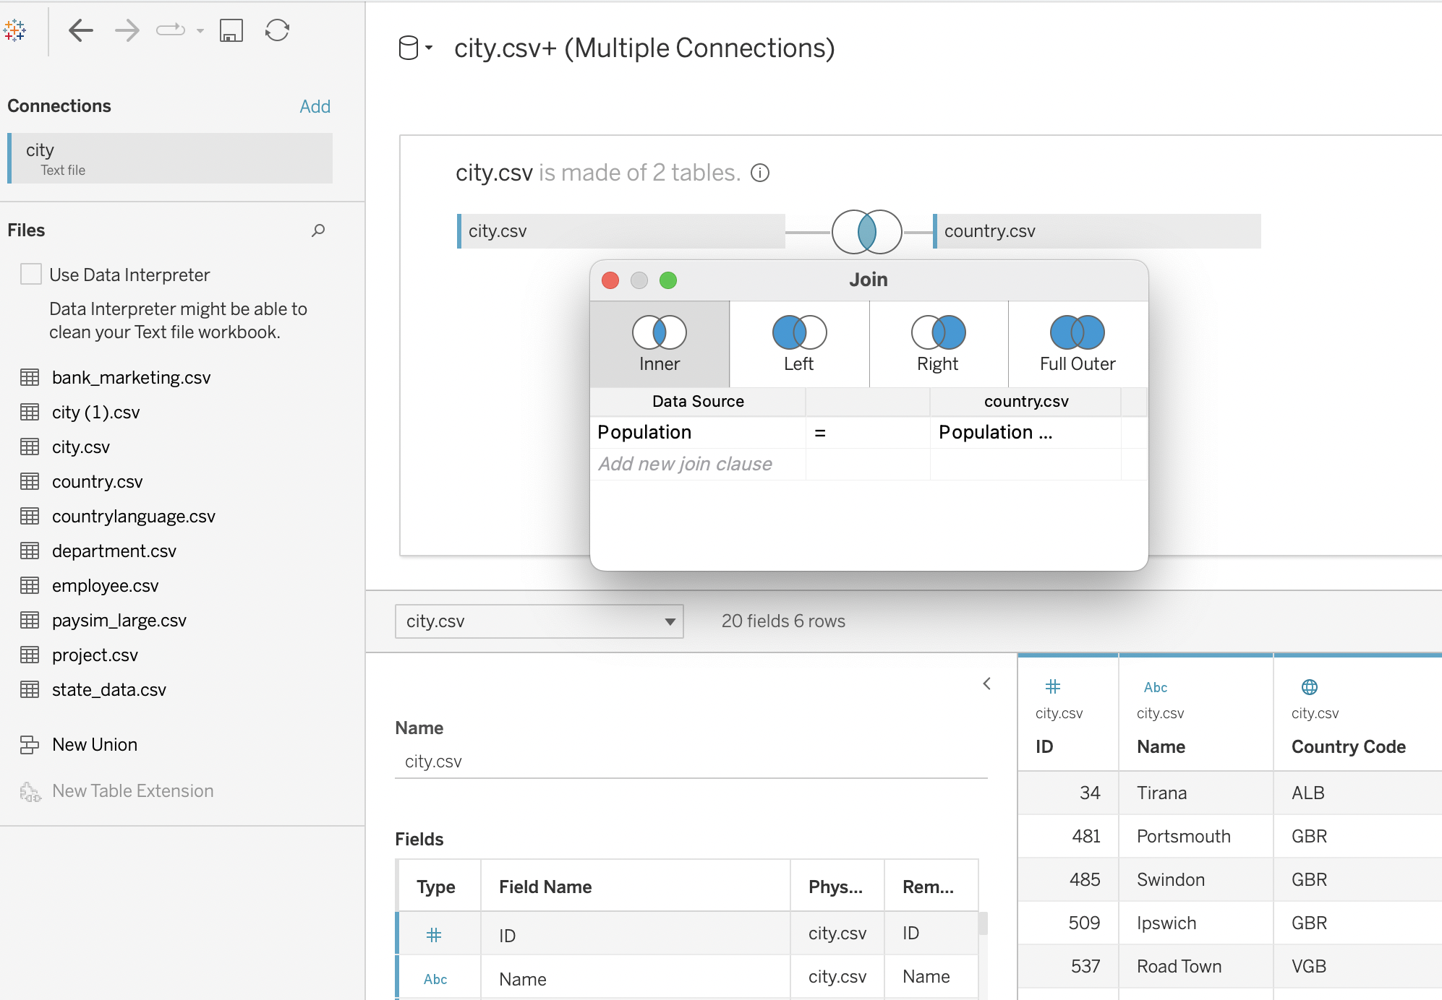
Recap: manually joining dataset using joins
Previously, Tableau utilized joins in order to merge and combine data.
It is still possible to join tables manually by specifying the precise variables the datasets will use as common keys, but this functionality is no longer the default.

Slide 8
Warm-up: finding a dataset
Spend a few minutes looking through the Kaggle (link) or Data.World (link) repository.
What kinds of data do you see that you might be interested in working with?
What kinds of data might you want to try to combine?
Notes:
The purpose of this slide is to make students aware of the Kaggle and Data.World repositories that were introduced during the Capstone presentation nd can be used to find a dataset for their capstone project. Give students 7 minutes to browse individually. Then ASK students to share the results of their browsing by turning on their microphones or leaving a note in the chat. This activity should take approximately 10-15 minutes total.

Slide 9
Module completion checklist
Objective | Complete
Manually join tables using joins
Introduce the concept of aggregating, binning, and grouping
Create and use bins and groups
Explore filtering capabilities of Tableau

Slide 10
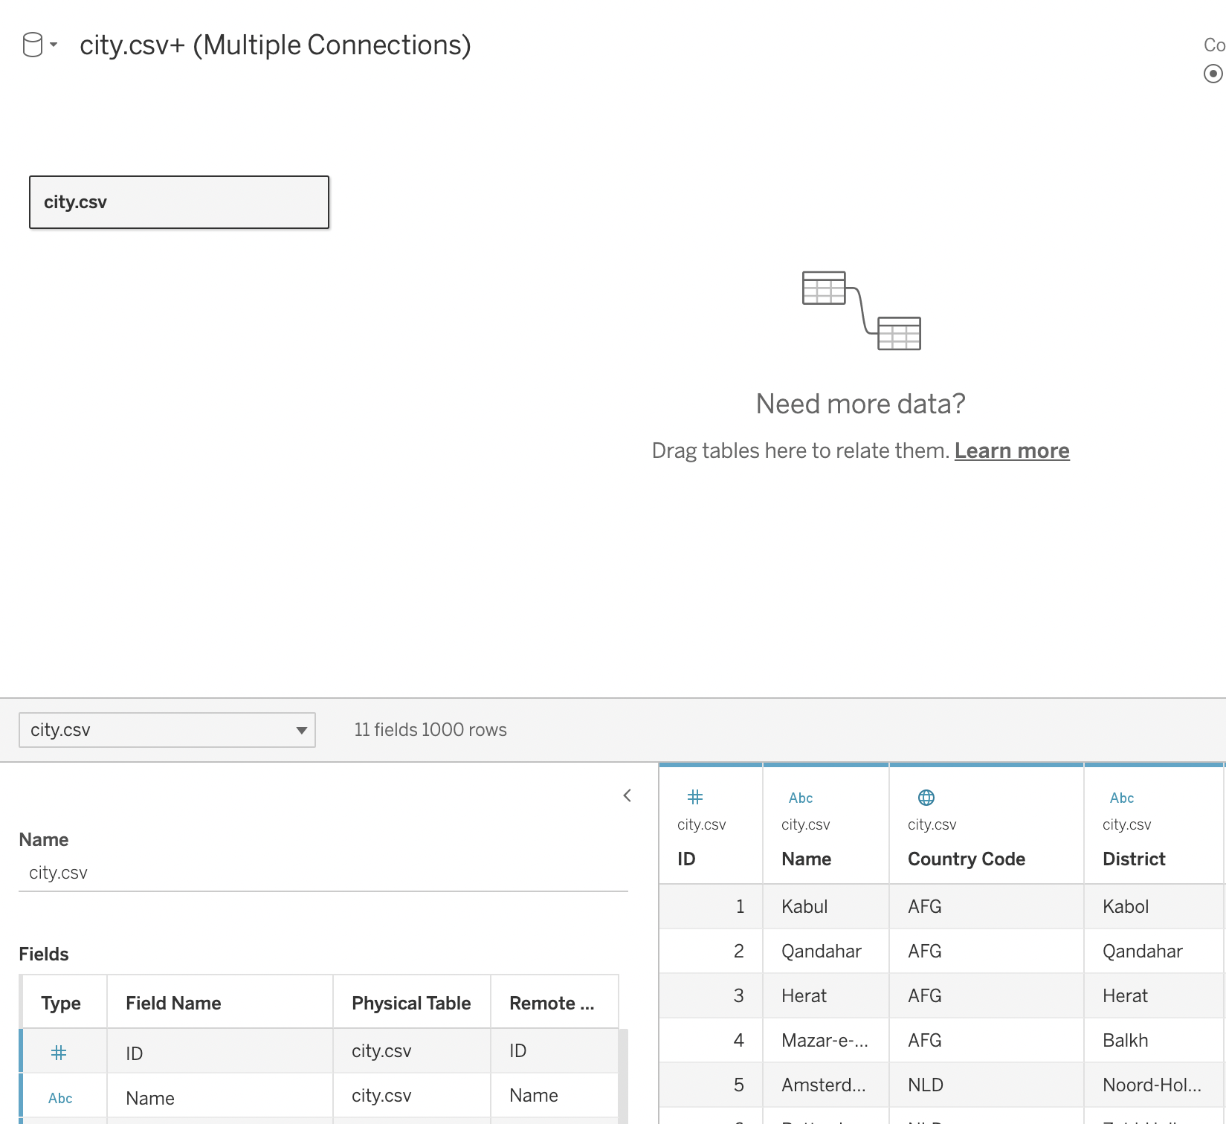
Joining the tables using joins
Let’s join the city, country, and countrylanguage tables using joins.
Step1: Drag the city table into the canvas.

Slide 11
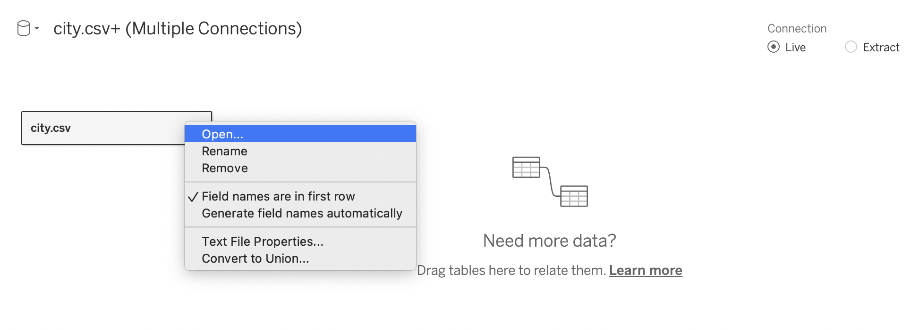
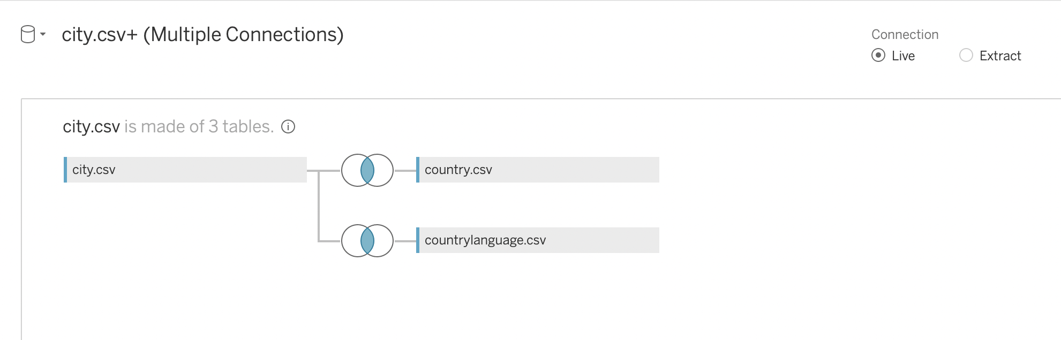
Joining the tables using joins, cont’d
Step 2: Select Open from the menu or double-click the first table to open the join canvas (physical layer).
Step 3: Double-click or drag country and countrylanguage table into the join canvas.

Slide 12
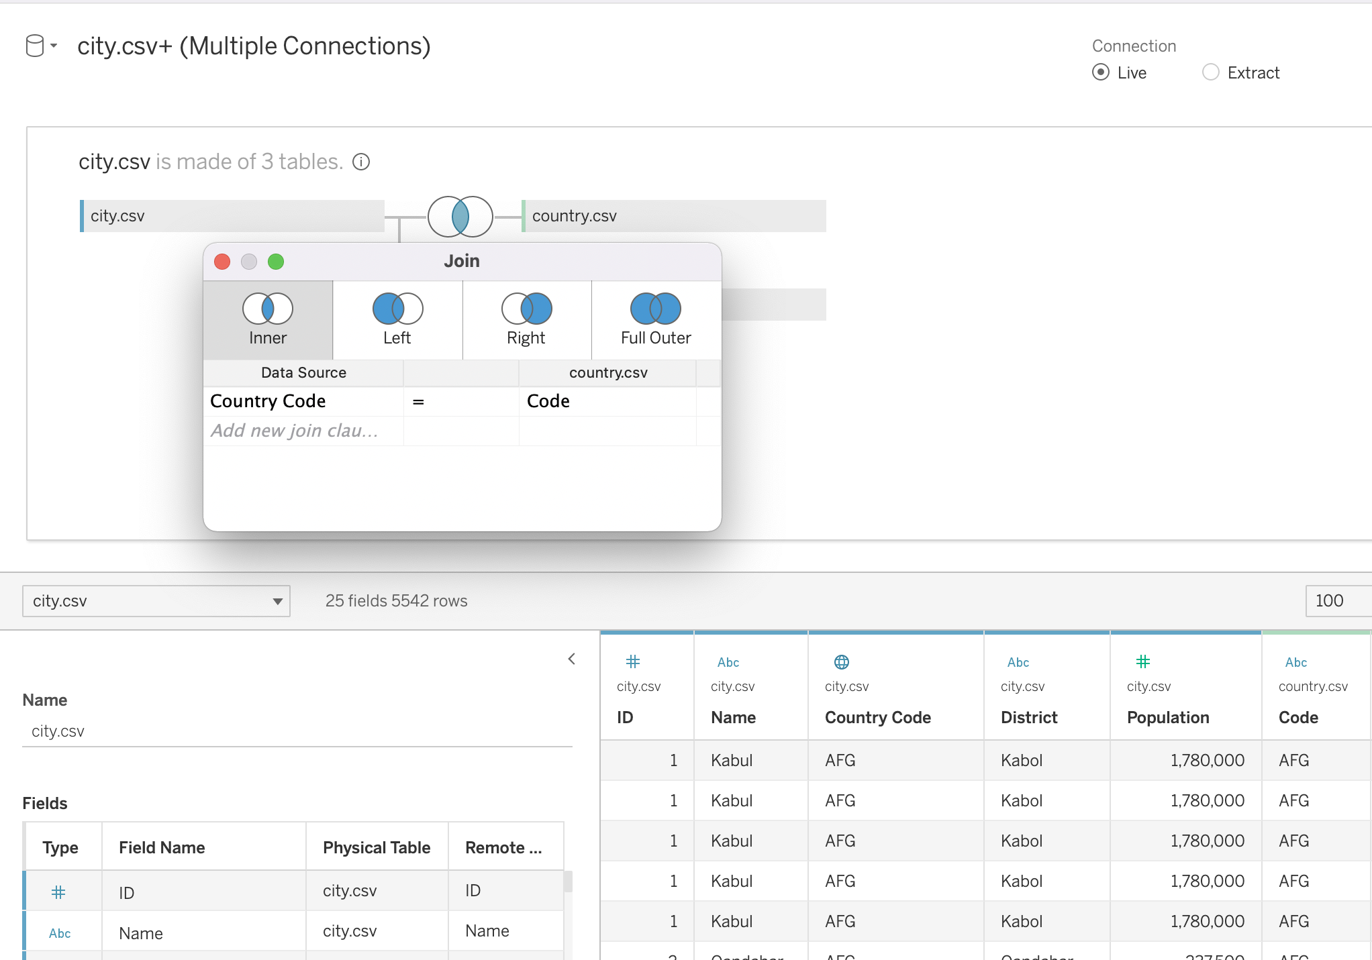
Joining the tables using joins, cont’d
Step 4: Click the join icon to configure the join.
In this use case, we’ll use inner join to join the tables.
The join clause is country code.

Slide 13
Module completion checklist
Objective | Complete
Manually join tables using joins
Introduce the concept of aggregating, binning, and grouping
Create and use bins and groups
Explore filtering capabilities of Tableau

Slide 14
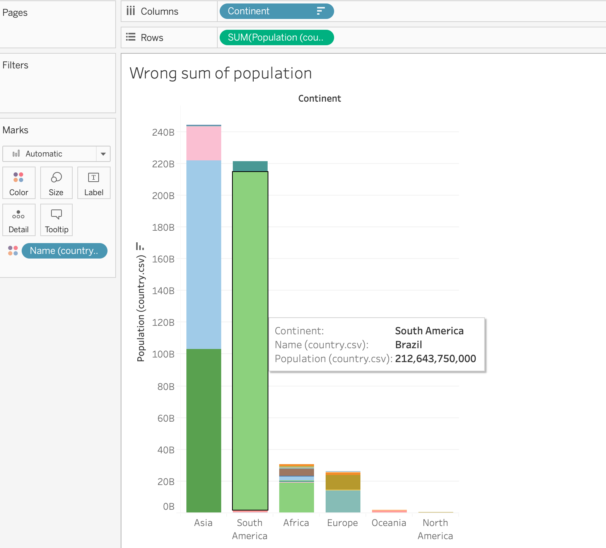
Data integrity
Let’s look at the summary population data by country.
Does this data make sense?
Is the population supposed to be in billions?
Are there 212 billion people in Brazil?
What could be wrong?
Notes:
The purpose of this slide is to begin directing students toward a possible problems with the dataset. WALK THROUGH how to generate the visualization on the slide. ASK the questions on the slide, and COMMENT on their responses.

Slide 15
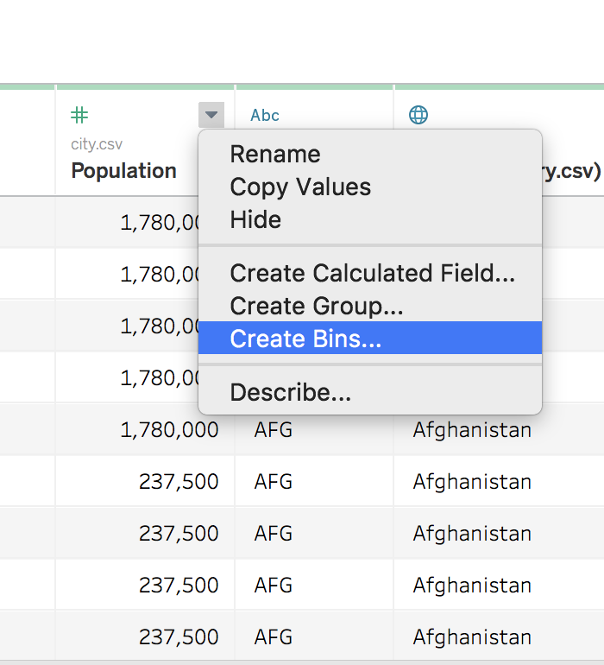
Aggregating, binning, and grouping
Sometimes it makes sense to format a column into chunks.
Aggregating: Using a formula to calculate on some grouping of the data.
Binning: Sorting continuous data into bins by value.
Grouping: Using manual assignment to categorize data.
Apply these with the dropdown menu to the right of each column.
Notes:
The purpose of this slide is to provide an overview of grouping, binning, and aggregation. DEFINE each chunking strategy and PROVIDE its associated command in the column dropdown menu.

Slide 16
Where do these groups appear?
Selecting any of these options will make new columns from the original column with some sort of summary of the column.
Let’s try this out on some of the world data.
Notes:
The purpose of this slide is to point out where the newly generated information will appear in the Tableau UI. It is also a transition into working with aggregation and grouping.

Slide 17
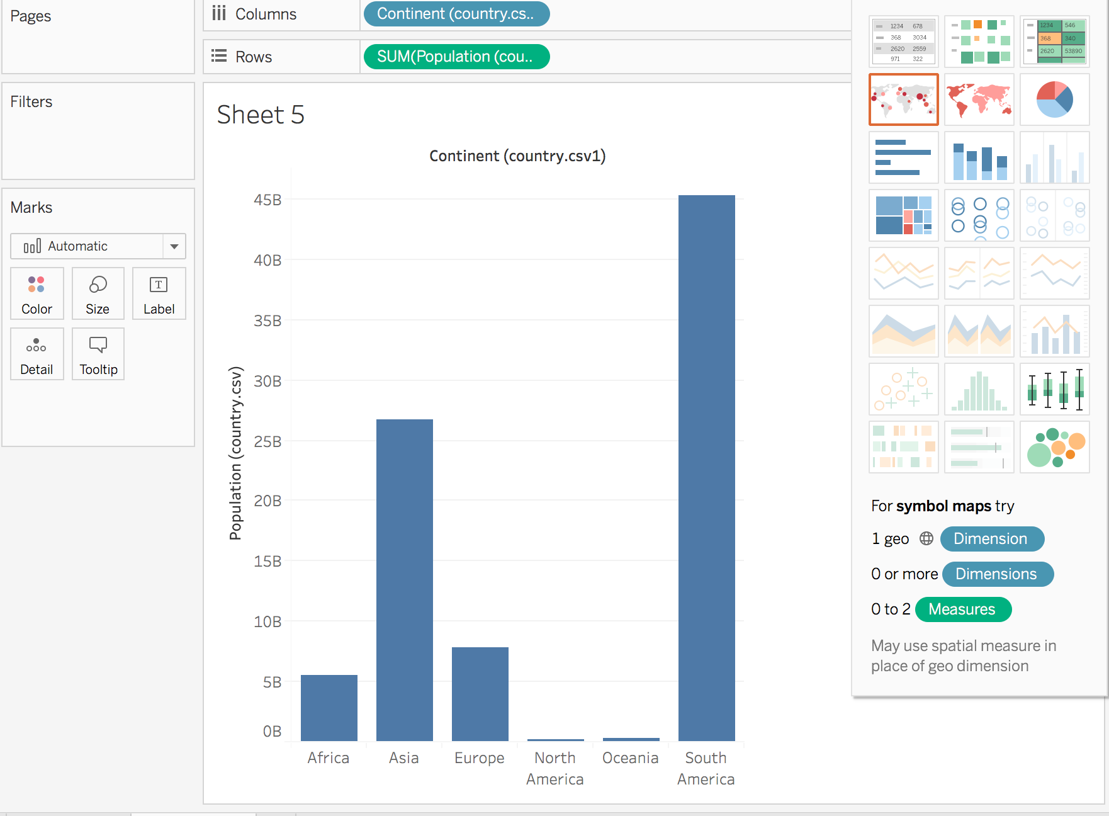
Data visualization: bar chart
We will look at the total population by continent.
Notes:
The purpose of this slide is to allow students to generate the first visualization to be manipulated this session, a bar graph for total population by continent. WALK THROUGH how to generate the image above.

Slide 18
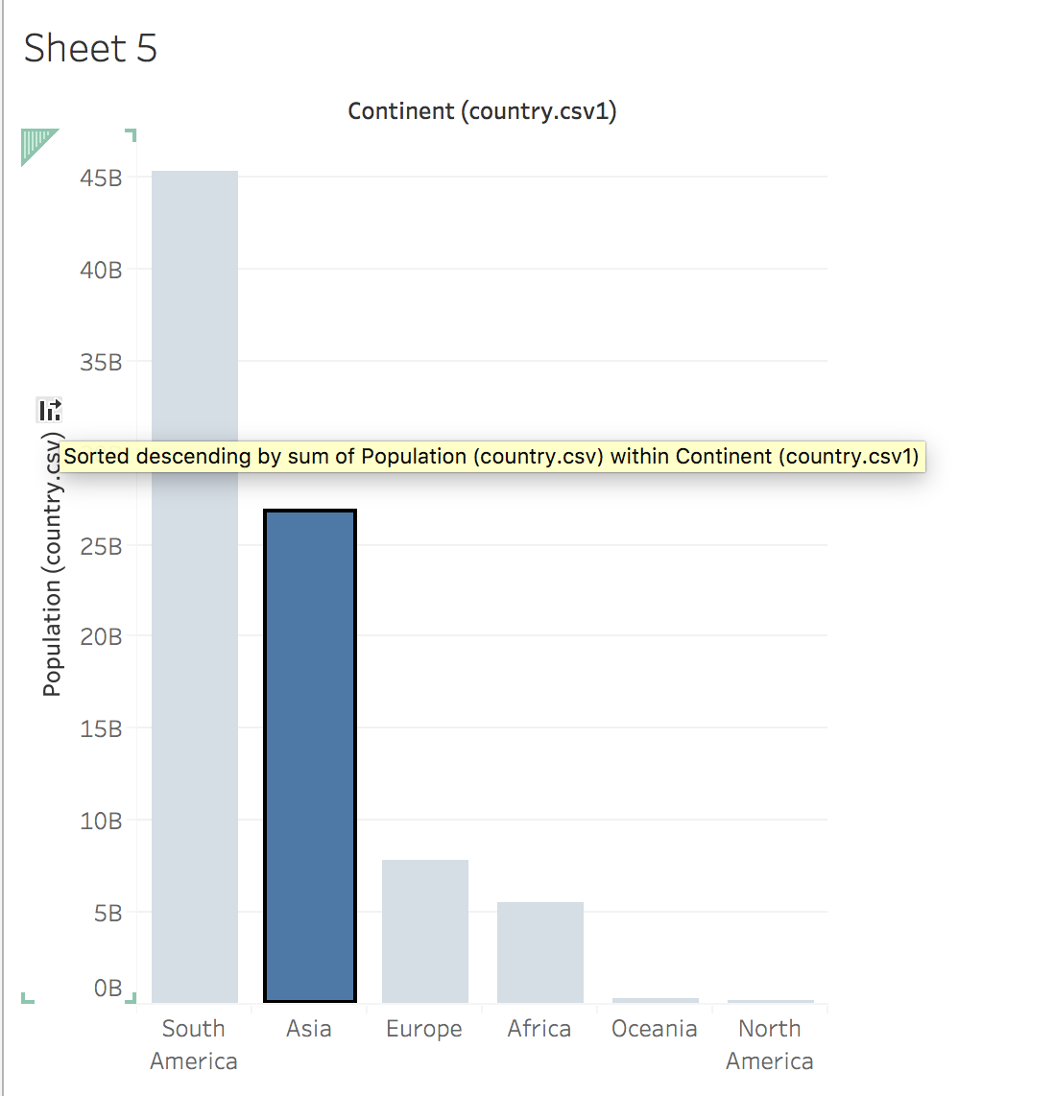
Sorting
We can sort by total population by using this icon, located on the appropriate axis.
Notes:
The purpose of this slide is to demonstrate how to sort plotted graph data by toggling the icon on the appropriate axis.

Slide 19
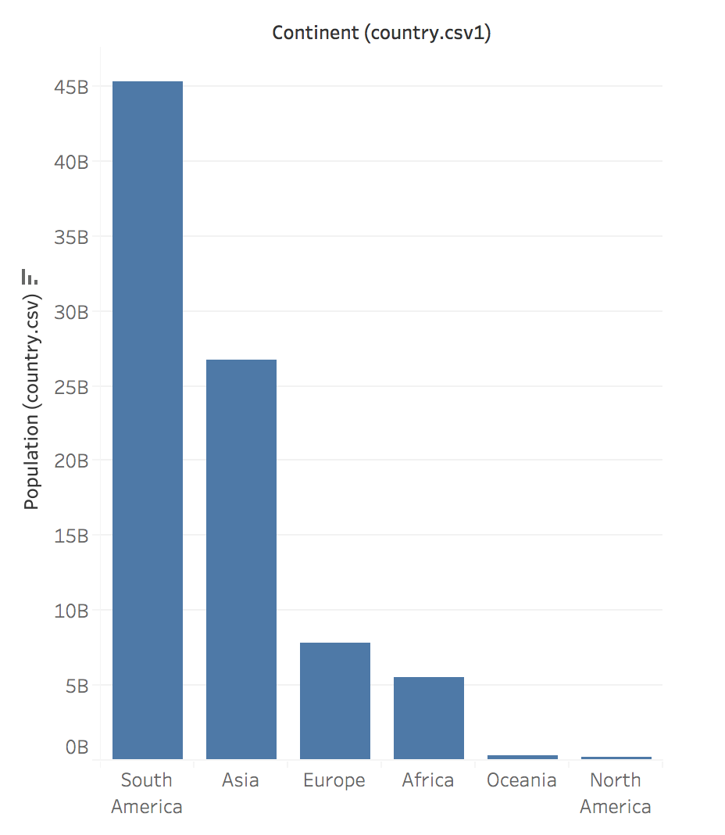
Data integrity
Does this data make sense?
Are there more people in South America than Asia?
What could be wrong?
In today’s Exercises, we will ask you to:
Rebuild these figures in your book.
Look for data integrity issues.
We will come back to fix them.
Notes:
The purpose of this slide is to draw students’ attention to how sorting the data has raised some potential data integrity concerns. REMIND students that we had similar concerns at the end of the previous session. ASK the questions on the slide, and COMMENT on their responses.

Slide 20
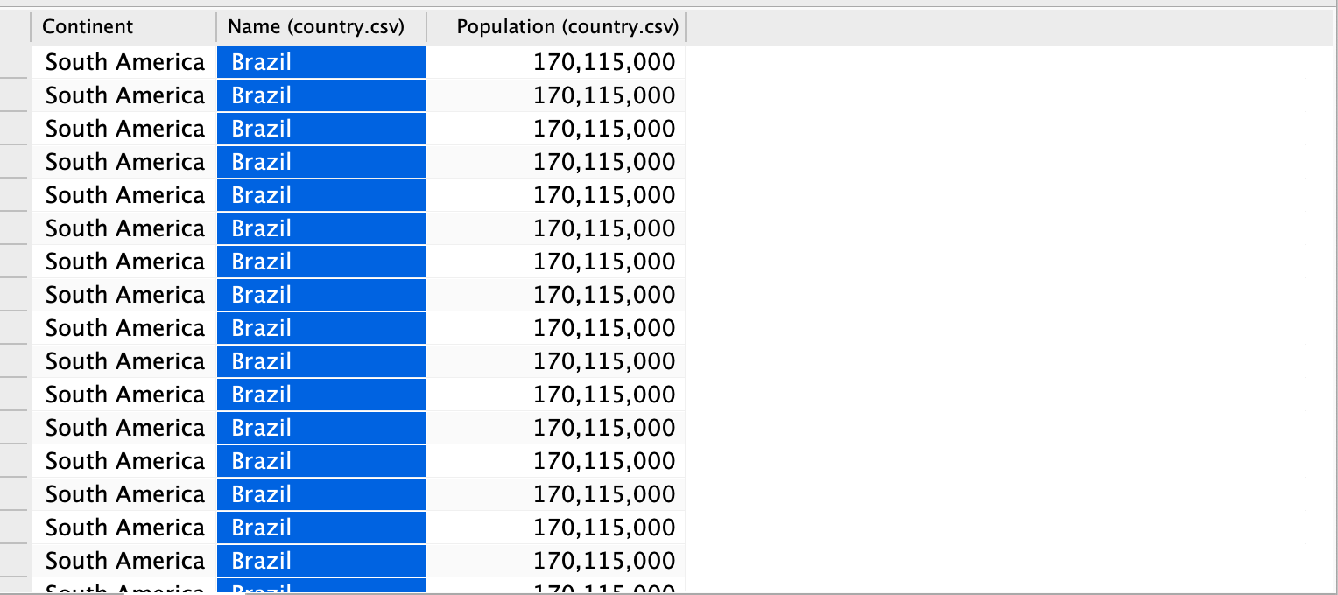
Aggregation in the data
Check the data – the only way such high numbers are arising is that the aggregation of population is wrong.
We want to calculate the population per continent with each country only represented once.
We can apply the ATTR (Attribute) argument to tell Tableau that the populations are an attribute of each country.
Note: Brazil has 170 million people.
Notes:
The purpose of this slide is to introduce the concept of aggregation in Tableau. SUGGEST that exploring the data reveals that Tableau may be counting population levels for the same country multiple times, if the value occurs on multiple rows of the table. EXPLAIN that we will need to change the way Tableau hierarchically organizes the data to get an accurate visualization.

Slide 21
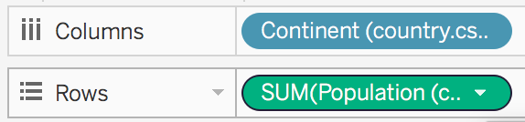
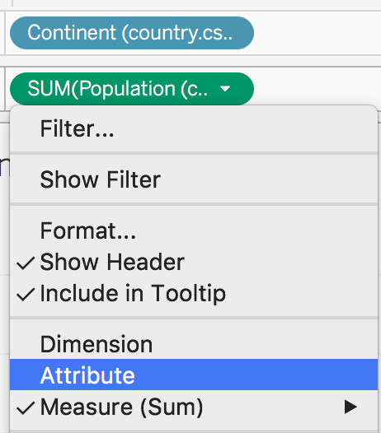
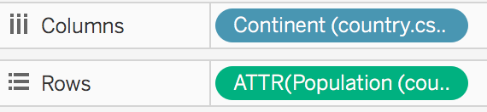
Aggregation and attribute
Look closely at the row and column shelves in the pills above the graph.
Population is being aggregated as a sum across all rows of each country.
Use the drop down in the pill and switch the aggregation to “Attribute.”
This means that the country level values are taken as an attribute of the data rather than being further aggregated.
Notes:
The purpose of this slide is to continue rectifying the data integrity problem by looking at how Tableau is aggregating population.
INSTRUCT students to hover over the population aggregation function to bring up the drop-down menu, then to switch the aggregation to “attribute.” EXPLAIN what this transformation has done to the data visualization.

Slide 22
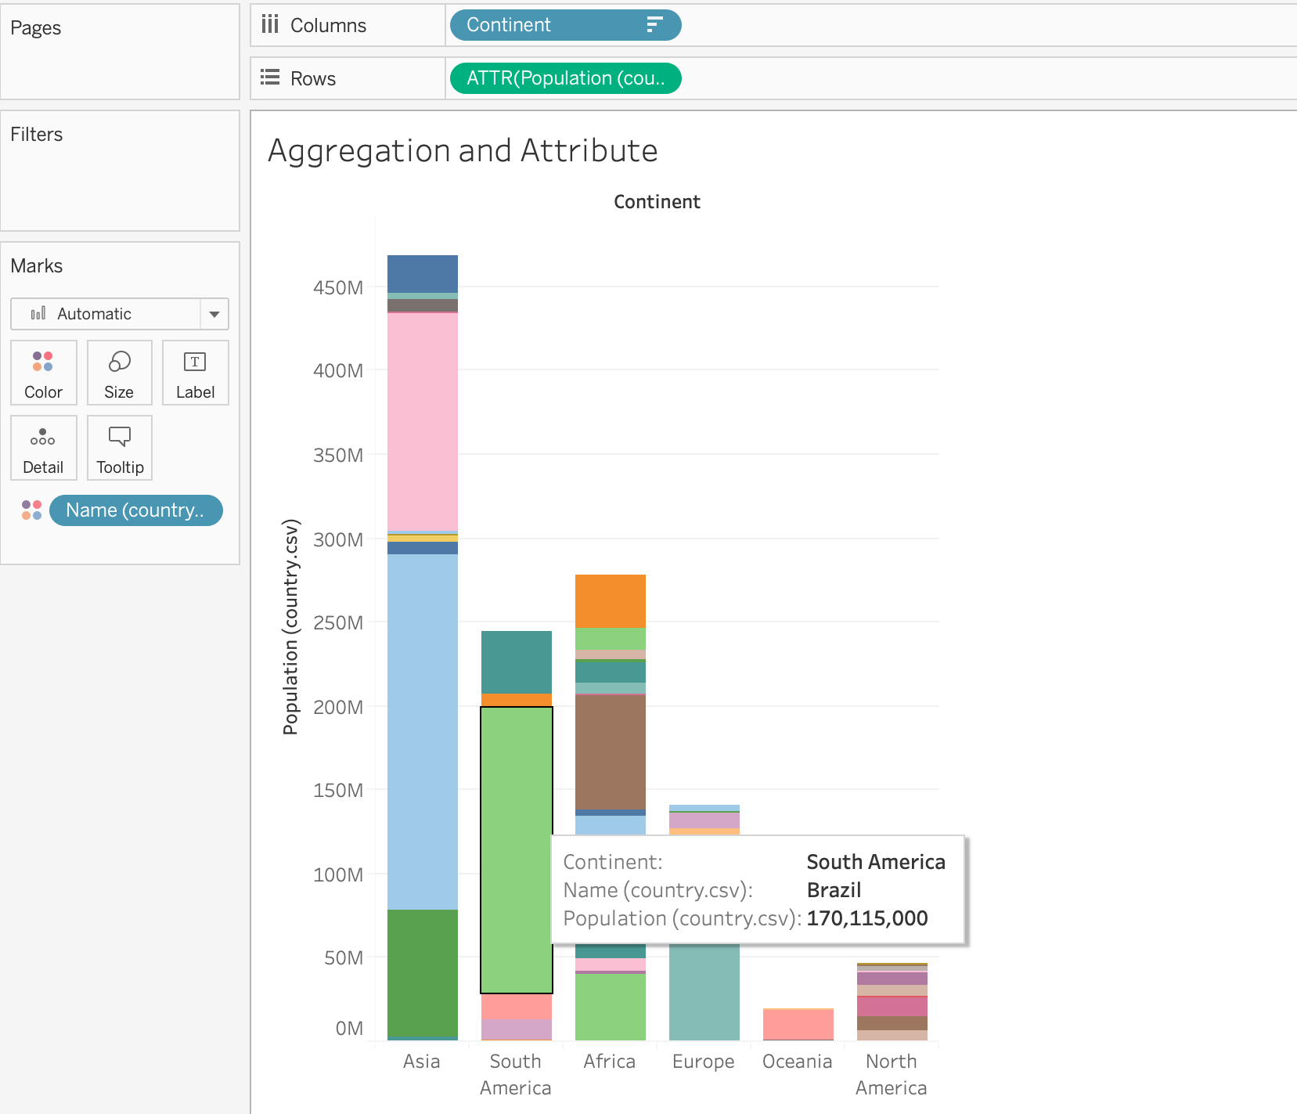
How has our visualization changed?
Now we are treating the country populations on each row as the whole population of each country, in other words as an attribute of the country.
Before, Tableau was treating each row as a part of each country’s population and summing it together.
We verify this by noting that the country populations are now as expected.
Notes:
The purpose of this slide is to revisit the bar chart visualization of population by country (by continent). POINT OUT how changing Tableau’s aggregation of population data has affected the visualization.

Slide 23
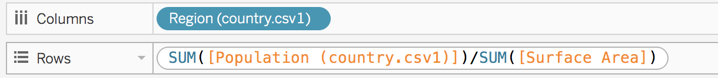
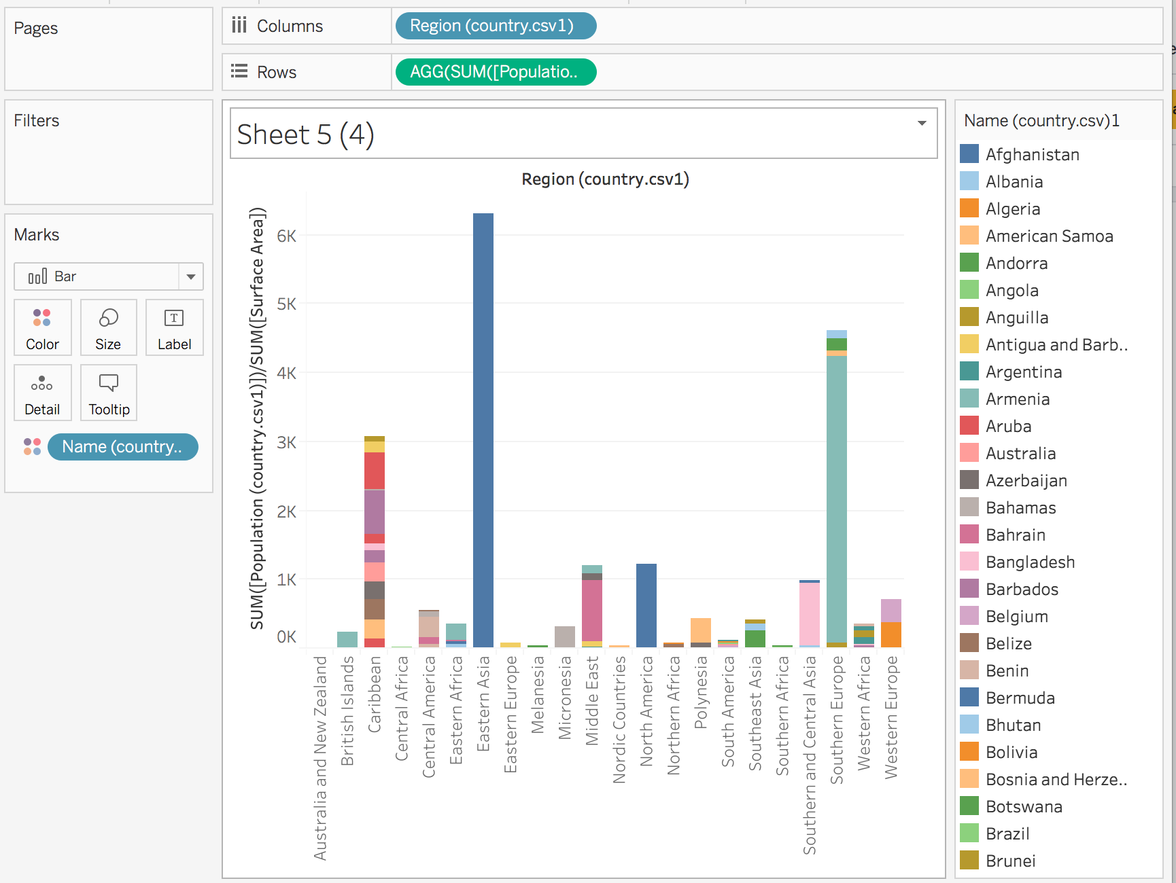
Aggregation: get population density
Let’s try plotting population density:
First, we add an aggregating dimension in the Columns field.
Then we write the aggregating formula in the Rows field.
When we press enter, Tableau makes an aggregation formula that calculates the new value per region.
Note that this is not a new column – rather, it is cast as “AGG().”
Notes:
The purpose of this slide is to demonstrate how aggregation formulas can be used to calculate other properties of the data. EXPLAIN the various inputs in the Columns and Rows fields, then REVIEW the aggregation formula and its effect on the visualization.

Slide 24
Module completion checklist
Objective | Complete
Manually join tables using joins
Introduce the concept of aggregating, binning, and grouping
Create and use bins and groups
Explore filtering capabilities of Tableau

Slide 25
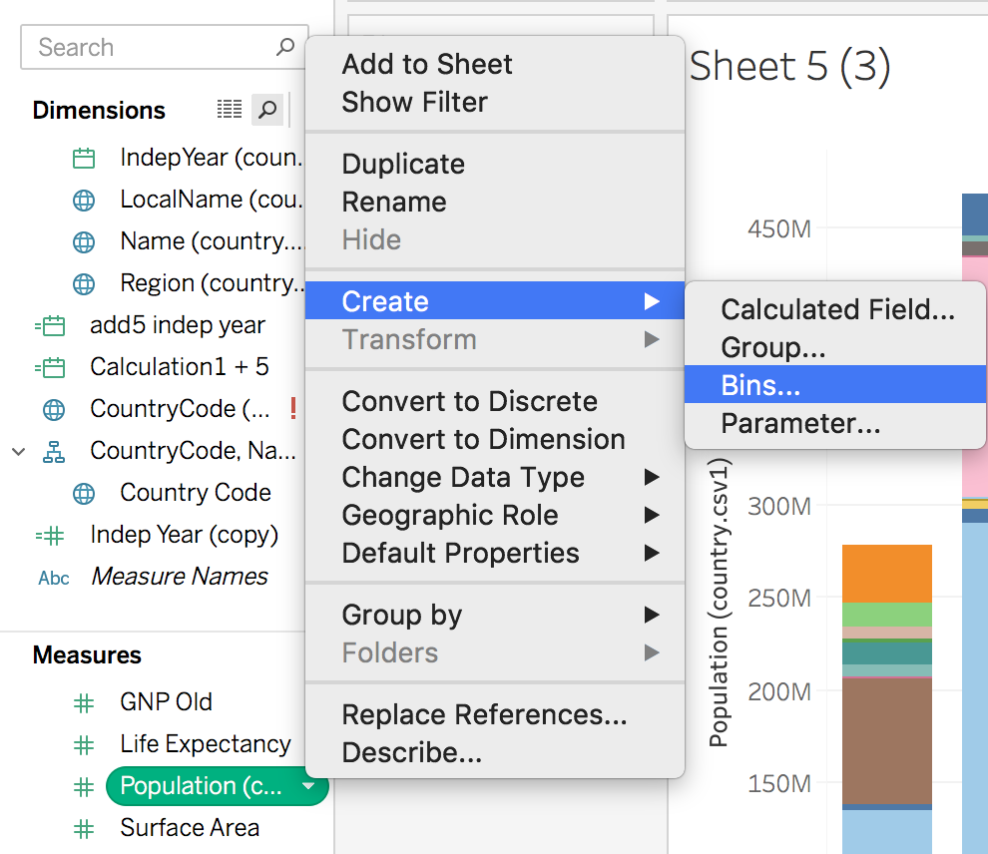
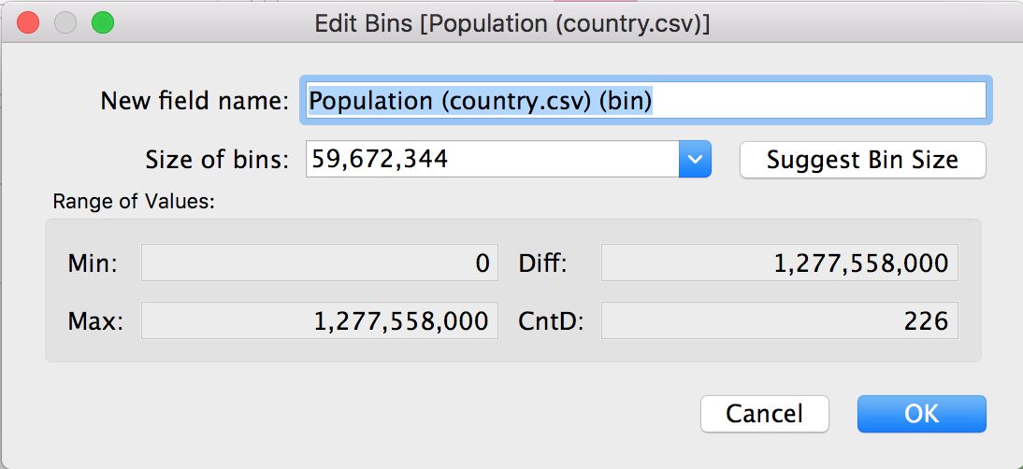
Binning
Now we will create bins based on the country’s population.
Binning can help us group many continuous values into smaller bins, or numerical ranges, for easier analysis.
Notes:
The purpose of this slide is to survey the concept of binning in Tableau. EXPLAIN what bins represent with respect to the dataset, then WALK THROUGH creating the “Population (country.csv) (bin)” as shown on screen. DEMONSTRATE the use of the Suggest Bin Size function.

Slide 26
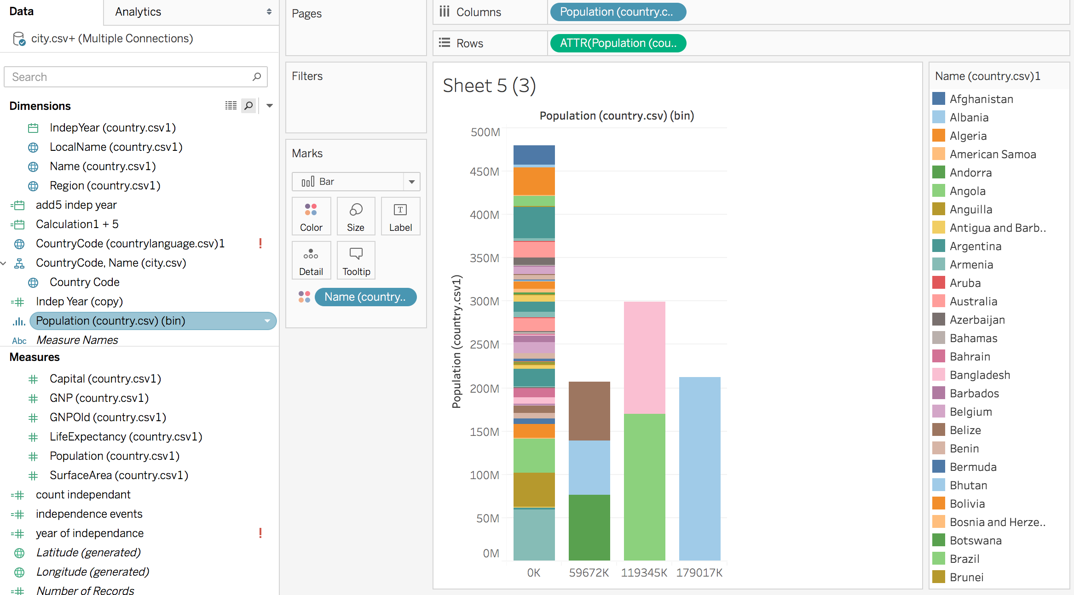
Binning, cont’d.
We can now can see that most countries fall into the bin with the smallest values.
Note that we are using the population attribute to keep Tableau from counting countries multiple times.
Notes:
The purpose of this slide is to show how the countries are sorted into the bins Tableau suggested.

Slide 27
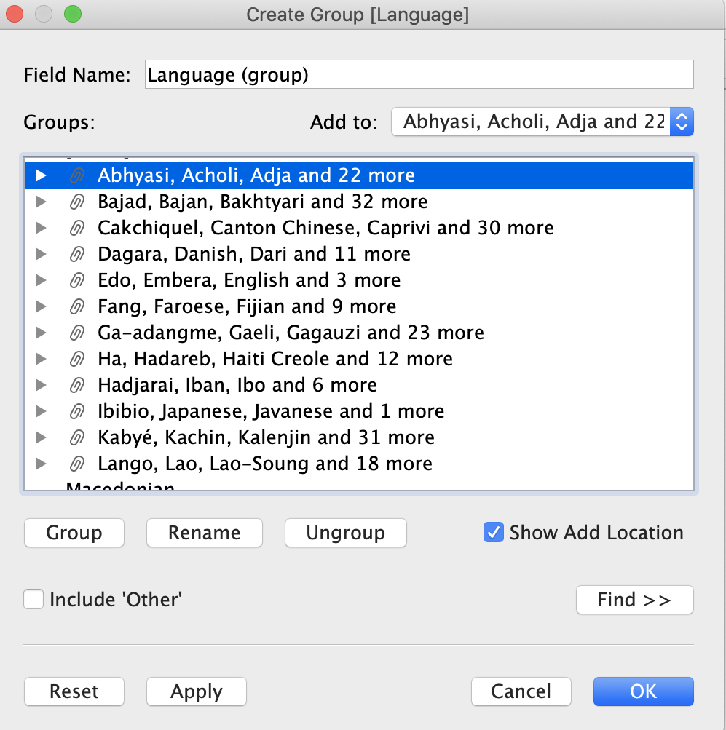
Grouping
If your data can be classed into obvious or natural categories, you might want to organize them using grouping.
You can specify groups manually.
For instance, languages might be grouped into different classes alphabetically.
Notes:
The purpose of this slide is to explain the concept of grouping in Tableau. EXPLAIN what groups represent with respect to the dataset, then WALK THROUGH creating the alphabetized “Language (group)” as shown on screen. DEMONSTRATE the creation of the categories here.

Slide 28
Knowledge check 3

Slide 29
Exercise 3

Slide 30
Module completion checklist
Objective | Complete
Manually join tables using joins
Introduce the concept of aggregating, binning, and grouping
Create and use bins and groups
Explore filtering capabilities of Tableau

Slide 31
End of Part 3

